Slide 1
References
1. Medical microbiology by:
Ernest Jawetz
Joseph Melnick
etc

Slide 2
2. Microorganisms in our world by:
Ronald M. Atlas
3. Microbiology, an introduction by: Tortora, Funke and Case.

Slide 3
Colour Atlas and Textbook of DIAGNOSTIC MICROBIOLOGY by:
Elmer Koneman
Stephen Allen
William Janda
et al.

Slide 4
Microbial metabolism
Sum total of all chemical reactions taking place in a living cell is referred to as metabolism.

Slide 5
METABOLISM is a life sustaining activity.
It is defined as ‘the ongoing interrelated series of chemical interactions taking place in a living organism that provide the energy and nutrient needed to sustain life.

Slide 6
Metabolism can be a chemical activity involving a particular substance:
Here it is defined as the chemical activity involving a particular substance in a living organism.
The by-product of that substance as a result of metabolism is called a metabolite.

Slide 7
Metabolic chemical reactions either release or require energy. Metabolism can be viewed as energy balancing act.

Slide 8
In living cells the chemical reactions that release energy are called catabolism.
It involves the breakdown of complex organic compounds into simpler ones.

Slide 9
Catabolic reactions breakdown chemical bonds to release energy. This is hydrolytic (ie similar to adding water to a hot object) this occurs when cells breakdown sugar into CO₂ and H₂0.

Slide 10
Anabolism describes energy requiring reactions ie the building of complex organic molecules from simpler ones. These reactions are anabolic or biosynthetic reactions. Examples are :
-the formation of proteins from amino acids
-Nucleic acids from nucleotides
-Polysaccharides from simple sugars.

Slide 11
Catabolic reactions generate energy needed to drive anabolic reactions. This is made possible through the molecule Adenosine TriPhosphate (ATP).

Slide 12
ATP stores energy derived from catabolic reactions and releases it later to drive anabolic reactions and to perform other cellular functions.

Slide 13
ATP is made up of Adenine, a ribose and three Phosphate groups.
During catabolism the phosphate group (p) splits away from ATP, Adenosine DiPhosphate (ADP) is formed and energy is released.
ATP catabolism ADP + energy .

Slide 14
The energy released is used to combine ADP and a (p) to synthesize ATP.
ADP + (p) + energy anabolism ATP

Slide 15
  Simple molecules eg
glucose, amino acids
glycerol, fatty acids.
Catabolic reactions ATP Anabolic
Transfer energy from reactions
Complex molecules ADP+(P) transfer
to ATP energy from
ATP
Complex molecules eg energy released
starch proteins and lipids

Slide 16
Chemicals reactions take place only when chemical bonds are formed or broken.
In order for reactions to take place atoms, ions, or molecules must collide.
The collision takes place due to energy acquired by the atoms, ions, etc.

Slide 17
This energy which provides enough collision impact for a reaction to take place is called activation energy.

Slide 18
Temperature and pressure are also required, and chemical reactions increase with increase in temperature and pressure.
Cells will die if temperature and pressure are increased high, so in living cells enzymes facilitate the chemical reactions.

Slide 19
Enzymes therefore act as catalysts; because they are in cells and tissues, they are called biological catalysts.
Enzymes exhibit a high degree of substrate specificity.
The enzymes a particular cell synthesizes determine which chemical reaction occurring in that cell.

Slide 20
During cellular metabolism coenzymes are involved to facilitate the reaction ie in the transfer of electrons and protons such as in redox-reaction.

Slide 21
The reduction of the oxidized coenzyme NAD⁺ to the reduced coenzyme NADH + H⁺ often leads to oxidation of substrates within a cell.
NAD⁺ is called nicotinamide adenine dinucleotide and it is the common temporary holder of electrons and protons.

Slide 22
Role of metabolism in the biosynthesis & growth
Microbial growth requires the polymerization of biochemical building blocks into
proteins,
nucleic acids,
polysaccharides and
lipids.

Slide 23
The building blocks must come preformed in the growth medium. Or must be synthesized by the growing cells.
Coenzymes are required to catalyze the reactions.

Slide 24
The biosynthetic origins of building blocks and coenzymes can be traced to relatively few precursors called focal metabolites. Eg:
Glucose 6-phosphate
Phosphoenolpyruvate
Oxaloacetate
α-ketoglutarate

Slide 25
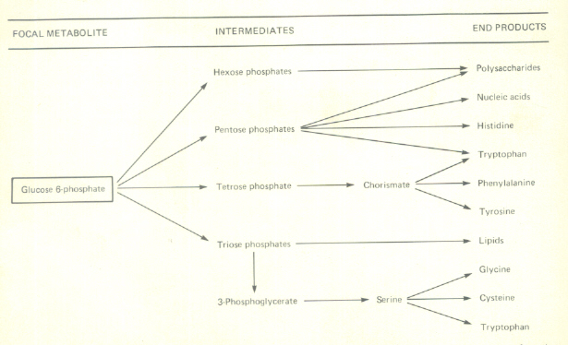
Products from Glucose 6-phosphate

Slide 26
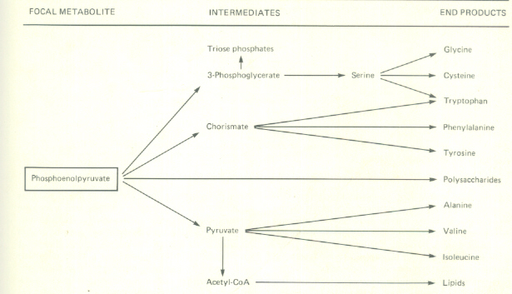
Biosynthetic end products formed from phosphoenolpyruvate.

Slide 27
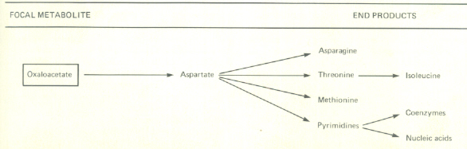
End products and intermediates from oxaloacetate

Slide 28
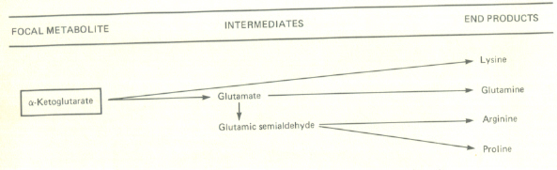
End products formed from α-ketoglutarate

Slide 29
Microbial metabolism can be divided into 4 categories
1. pathways for the interconversion of focal metabolites
2. assimilatory pathways for the formation of focal metabolites.
3. biosynthetic sequences for the conversion of focal metabolites to end products
4. pathways that yield metabolic energy for growth and maintenance.

Slide 30
When provided with building blocks and a source of metabolic energy a cell synthesizes macromolecules.
The sequence of constructing building blocks within a macromolecule is done in 2 ways:
1. nucleic acid and proteins are template directed. DNA serves as the template for the synthesis of itself and for the synthesis of various types of RNA; messenger RNA serves the template for the synthesis of proteins.

Slide 31
2. in carbohydrates and lipids the arrangement of building blocks is determined entirely by enzymes.

Slide 32
Microbial nutrition

Slide 33
Nutrients
Nutrients in growth media must contain all elements necessary for biologic synthesis of new organisms
The microorganisms have developed diff metabolic pathways to break down organic molecules into its constituents…NH₄⁺, CO₂, SO₄⁻, PO₄⁻ etc. Some utilize inorganic materials to obtain energy.

Slide 34
Carbon
Bacteria which are able to use CO₂ and H₂O and light are called autotrophs. Eg in photosynthesis.
Those that use inorganic substances like Hydrogen, sulphur, carbon dioxide are called chemolitotrophs.

Slide 35
Heterotrouphs are organisms which require organic carbon for growth.
Glucose can provide the carbon and energy needs for many types of bacteria but the level that will support the growth of one will inhibit the growth of others.

Slide 36
Nitrogen
Nitrogen is a major component of proteins and nucleic acids.
Many organisms are able to assimilate nitrate (NO₃) and Nitrite (NO₂) by converting these ions into ammonia (NH₃)

Slide 37
The ability to assimilate N₂ via NH₃ is called nitrogen fixation. Some organisms can utilise ammonia as a sole nitrogen source.

Slide 38
Sulphur
It is a major component of many organic cells. It forms part of the structure of coenzymes and proteins. Many bacteria can use sulphate (SO₄²⁻ )as sulphur source reducing the sulphate to sulphite then to hydrogen sulphide (H₂S). Some assimilate H₂S directly from growth medium.

Slide 39
Phosphorus
Phosphate PO₄³⁻ is required as a component of ATP, nucleic acids and coenzymes such as NAD and NADP and flavins.
Phosphate is assimilated as free inorganic phosphate (Pi)

Slide 40
Minerals ie trace elements
Many minerals are required for enzyme function.
Mg²+ and Fe²+ are required in porhyrin
Mn2+ is required for chlorophyll
Mg and K are required for ribosome function.
Ca²⁺ for cell wall in gram positive organisms
MN²⁺, MO^{2+,} CO²⁺, Cu²⁺, Zn²⁺ are required for other metabolic functions.

Slide 41
Growth factors
A growth factor is an inorganic compound which a cell must contain in order to grow but which the cell is unable to synthesize.
When all nutrients are provided the cell must be able to synthesize amino acids, purines, pyrimidines, vitamins which serve as precursors for coenzymes.

Slide 42
Some vitamins and functions
p-Aminobenzoic acid—precursor for folic acids and coenzymes.
Folic acid– for carbon transfer
Nicotinic acid—NAD and NADP precursors for hydrogen transfer.
Vitamin B12 –for molecular rearrangement
etc

Slide 43
Oxygen
Obligate aerobes ---require oxygen for growth eg pseudomonas.
Facultative anaerobes---will grow whether there is oxygen or not eg E. coli.
Obligate anaerobes ---require no oxygen eg the Clostridia.
Cf…

Slide 44
Cf:
Aerotolerant anaerobes…
Cannot use oxygen for growth but tolerate it fairly well.
They do not require special treatment for growth in the lab.
Microaerophils
Are aerobic . But require oxygen at lower concentration than air.

Slide 45
Radical oxygen (O²⁻ )
This is toxic to most microbes
In cells superoxide free radicals of oxygen are produced during respiration and it is toxic to microbes so must be neutralised.
So the microbe produces enzyme called superoxide dismutase to convert the oxygen radical O²⁻ to molecular oxygen O₂ and hydrogen peroxide,( H₂O₂ ).

Slide 46
The hydrogen peroxide produced this way is also toxic because it exists as O₂²⁻ in water. Microbes have developed enzymes to neutralise this one too. So enzyme catalase is used to convert it to water and molecular oxygen.
Others produce peroxidase which convert it to hydroxyl radical (OH⁻) which combines with oxygen to neutralise it.

Slide 47
Culture media
A nutrient prepared for growth of microorganisms in the lab is called culture medium.
It is composed of biological or chemically derived material for growth of microorganisms.

Slide 48
Some bacteria grow on any kind of culture medium. Others do not grow on artificial media but on living cells (animal inoculation).
Others still cannot be grown at all in any medium yet developed.

Slide 49
Cultivation of microorganisms
For a particular organism to be cultivated in the lab, the medium must:
1.have the right nutrients for the specific microorganism.
2. contain sufficient moisture
3. have properly adjusted pH
4. have suitable level of oxygen, perhaps none at all.

Slide 50
5. the medium must be sterile
6. and incubated at the proper temperature.

Slide 51
Most of the media are commercially available in dry pre-mixed forms.
When a solid medium is needed agar is added.

Slide 52
Agar
Agar is a complex polysaccharide derived from seaweeds.
The liquid medium is called broth.
Different kinds of media are still being developed for isolation and identification of bacteria in fields such as food, water and clinical microbiology.

Slide 53
Chemically defined media
These are those whose exact chemical composition is known. eg

Slide 54
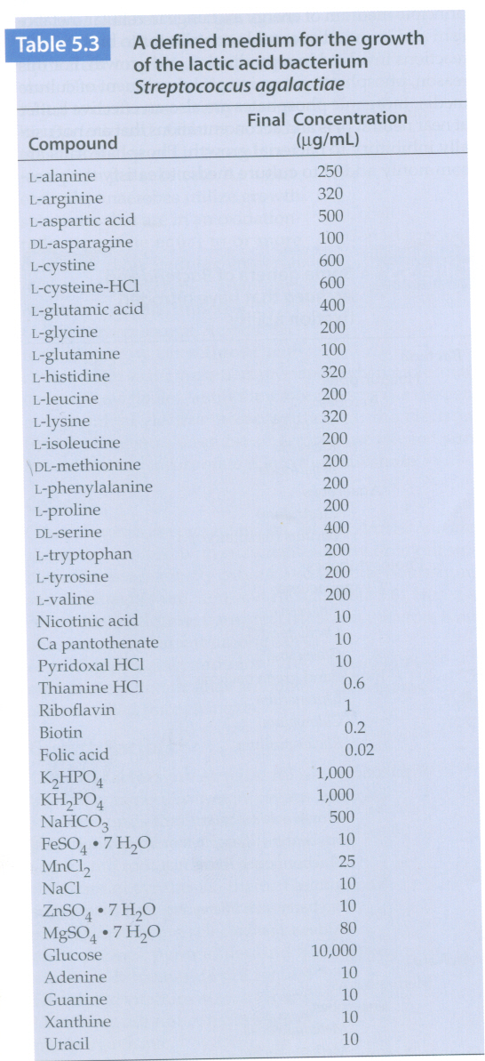

Slide 55
Complex media
The exact (or specific) nutrients are not defined. But substances like meat extract, beef heart or brain, whole blood, yeast extract, amino acids, peptones are included.
These are to provide all the nutrients, vitamins and minerals needed for growth.

Slide 56
Anaerobic growth media
Oxygen kills many bacteria, so special media and techniques are used.
Otherwise they are grown in special jars from which oxygen is removed.

Slide 57
Selective and differential media
Selective media are used to suppress the growth of unwanted bacteria and encourage the growth of the desired microbes.eg Salmonella-shigella, manitol salt agar.
Differential medium distinguishes colonies of desired organism from other organisms growing on the same plate., Mac, Cled

Slide 58
Enrichment medium
Bacteria in a sample can be in small numbers and can be missed. So it is sometimes necessary to use an enrichment medium. The enrichment medium is designed to increase the small numbers of the desired organism to detectable levels.
Eg soil and faeces. Selenite-F Broth

Slide 59
Enrichment procedure is often employed when one considers to isolate a particular bacterium from a natural source containing many other microoganisms.

Slide 60
Transport medium
This is used to transport samples to the lab.
They keep the organisms from death and further multiplication. Eg of transport media
Carrey-Blair
Stuart and
Amies.

Slide 61
Pure culture
Pure culture is obtained if a single bacterial cell grows into a colony. The progeny from that cell is kept in a culture medium. It contains only one type species.
Many ways of doing this:
i. Pour-plate method
ii. Streak method

Slide 62
Growth of bacteria
Growth in microbiology is the increase in bacterial numbers not an increase in size of the individual cells.

Slide 63
Binary fission
This is the cell division process:
1. cell elongation and xsomal replication
2. cell wall and membrane grow inwards
3. in-growing walls meet forming a cross wall.
4. two individual cells are formed
A few produce by budding. Others form spores. Filamentous form fragment.

Slide 64
Generation time
This is the time required for a cell to divide into 2 - ie its population to double.
Most bacteria have generation time of 1-3h. Others require more than 24h.
E. coli has generation time of about 20m.
Mycobacterium has 24h.

Slide 65
Exponential growth
When all nutrients are available in moderate quantities and environmental conditions are favourable biomass will increase exponentially with time.

Slide 66
The growth curve
If a liquid medium is inoculated with microbial cells of a previous culture the curve below is obtained

Slide 67
GROWTH CURVE
D
e
Biomass
F
c
A
B
Time
a

Slide 68
Section of curve: Phase: growth rate
A lag zero
B acceration increasing
C exponential constant
D Retardation decreasing
E maximum stationary zero
F decline negative (death)

Slide 69
Lag phase
Bacteria adjust to the new medium. Undergo intense metabolic activities involving DNA and enzyme synthesis.

Slide 70
The exponential (Log) phase
B is the beginning of time for cells to divide.
Then the real exponential phase is reached. At the exponential (log)phase cellular division is most active and doubling time is constant. At this time microorganisms are most sensitive to adverse conditions such as drugs, eg penicillin and radiation which interfere with growth processes.

Slide 71
The stationary phase: E
Phase D is the point where cell division is beginning to slow down. Then the stationary phase is reached where cells begin to die and some divide to balance the deaths.
Here there is slow death of cells which is just balanced by the formation of new cells leading to the period of equilibrium.

Slide 72
Death phase or decline
Either exhaustion of nutrients or accumulation of waste products harmful changes in pH play a role to halt cell division. The number of dead cell increase until all cells die completely. This takes a few days. Some retain surviving cells almost indefinitely.

Slide 73
Requirements for growth
Divided into 2:
A:- Physical—Tempt, pH and osmotic pressure
B:- Chemical –water, source of carbon, N, O, organic growth factors.

Slide 74
Psychrophiles:- cold loving microbes
Mesophiles:-moderate temperature microbes
Thermophiles:- Heat loving microbes

Slide 75
Most microbes thrive in temperature ranges.
But grow best at the optimum temperature

Slide 76
pH :- Most bacteria grow in a narrow pH range.
Most pathogenic bacteria grow in a pH range of 6.5-7.5
Most microbes are cultivated in a solution whose osmotic pressure balances that of the microbial cell to avoid plasmolysis.
Halophiles tolerate high salt concentration.

Slide 77
Death
Cell death means irreversible loss of ability to reproduce (divide). Death test is performed by culture of cells on solid media. Death is achieved if it fails to form a colony on the agar plate.

